Slide 1
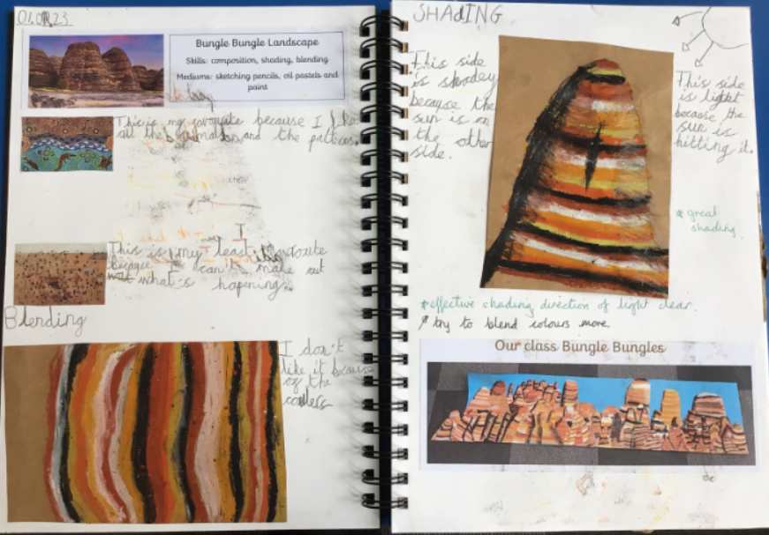
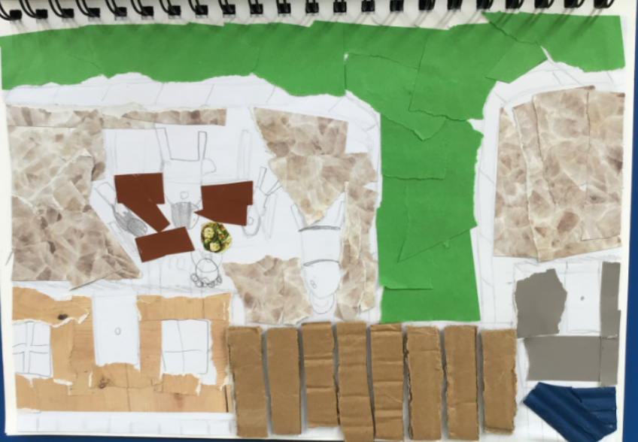
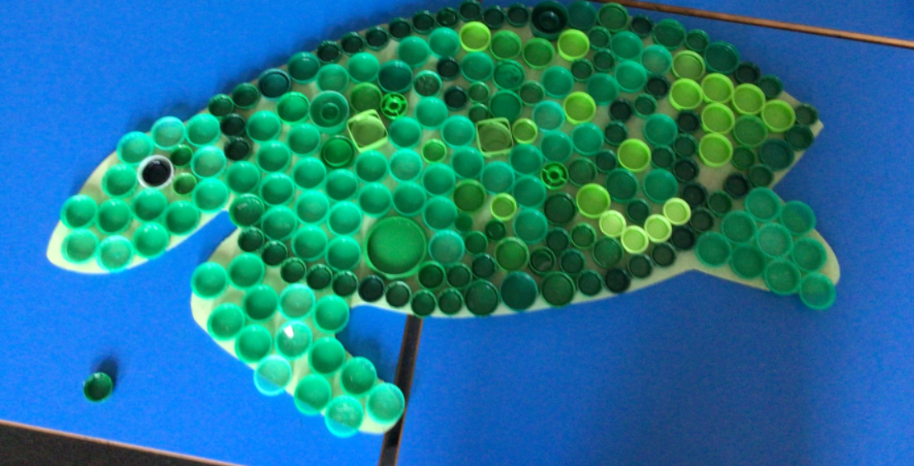
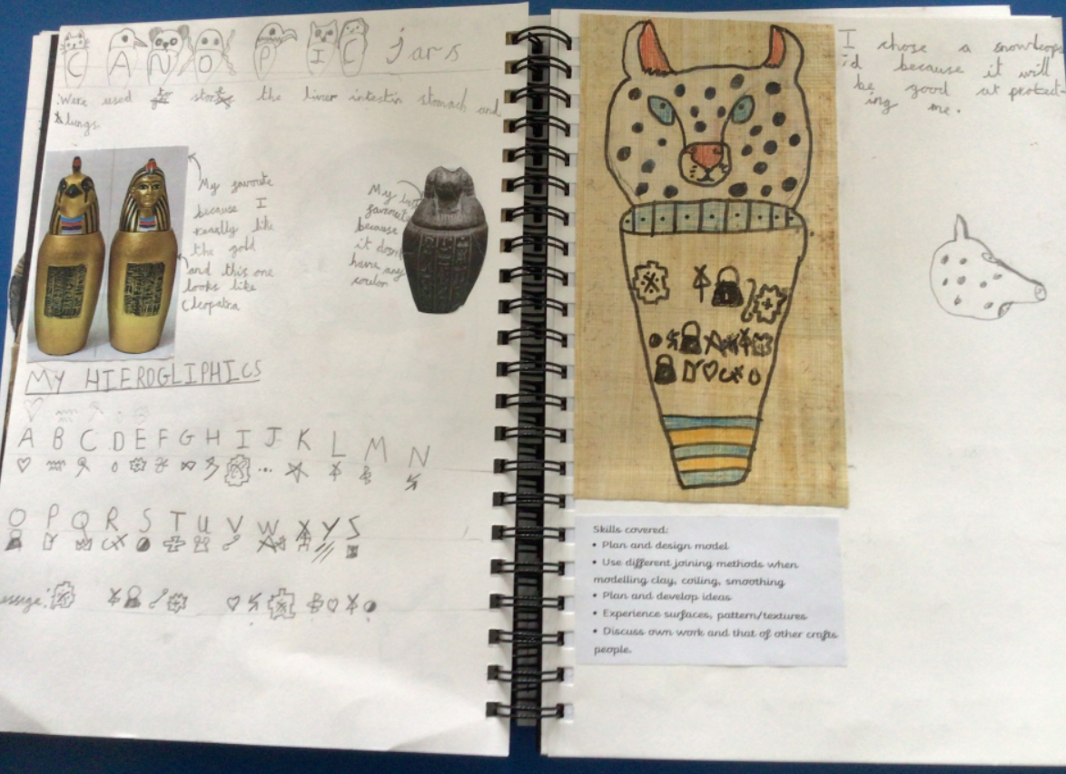
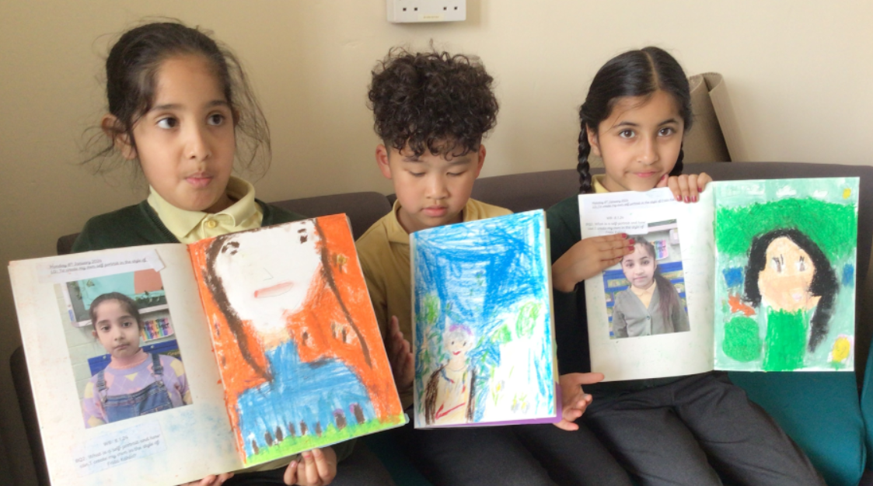
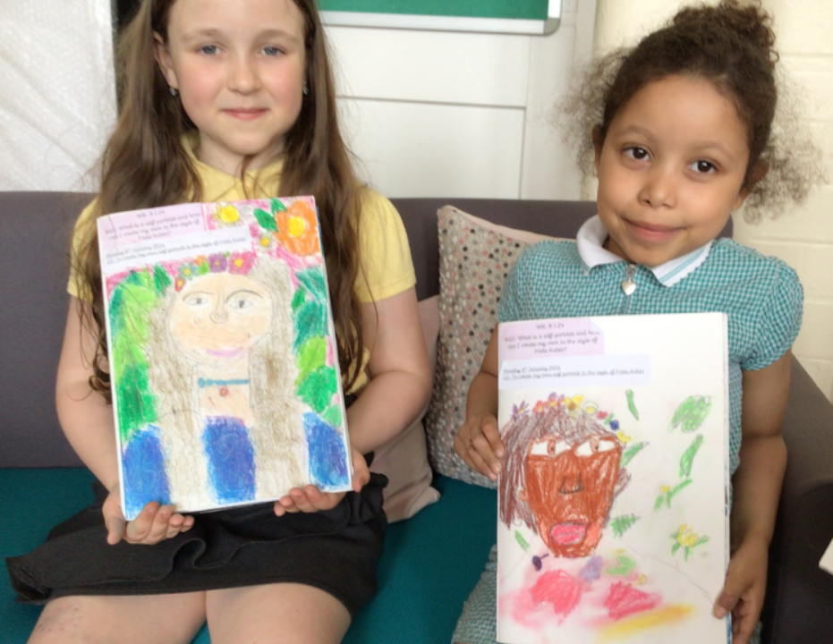
Art at Avenue

Slide 2
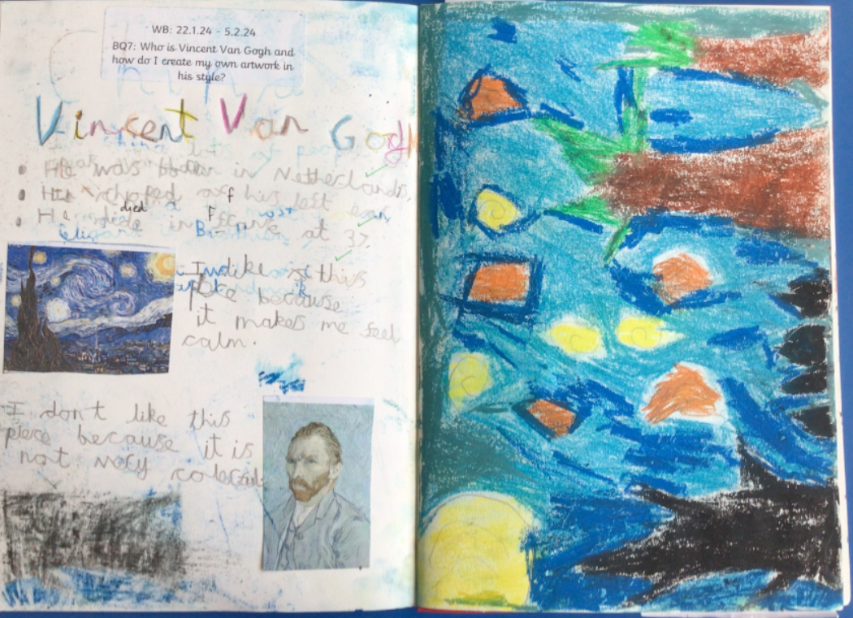
Where are we with art currently?
Rhiannon Ross is our lead on art and has been for the last 4 years.
Over the last two academic years, we have made changes with regard to what art looks like in sketchbooks.
A guide to sketchbooks was shared with the staff and monitoring of sketch books has taken place. This has improved the quality of the sketch books and how they are being used.
The structure for lessons that has been shared through the sketchbook guide, has resulted in an improvement in the quality of the learning the children are producing and the ability to form opinions on their own work and that of other artists.
Where possible we link the art that we do to our topic and alternate half termly between art and design technology.
We tend to block off the art and have a set day per half term rather than do weekly art lessons. We feel this is more beneficial time wise and means we are not rushing to squeeze it in.
Rhi has adapted the planning and book scrutiny checklist so they identify what she wants to see when she looks at the sketchbooks and planning during monitoring and evaluation activities.
Since last year Rhi has run an Artist club to raise the profile of Art and allow for extra Artists and skills to be covered throughout the year such as batik, screen printing and looking at range of Artists.
More emphasis is shared with the children about the skills being covered and the mediums being used at the beginning of the session so the children are clear.

Slide 3
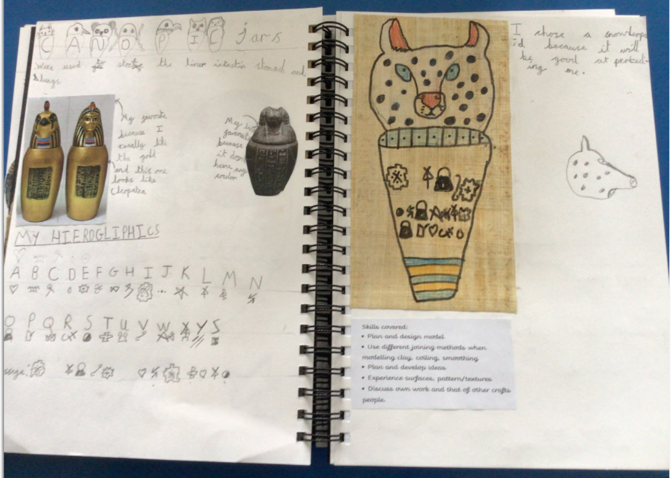
Headlines from Pupil Interviews
Years 1 and 2
Really enjoyed the Artists topic
Could name some skills used
Named some artists but not confidently
Enjoyed trying different things, but wanted to do more free drawing
Years 3 and 4
Named lots of art, Egyptian Canopic jars, Stone Age art, Chinese Culture Art, Landscape, NHS competition
Spoke confidently about skills learnt
Would like to do more painting and free drawing/painting
Year 5 and 6
Enthusiastically could recall art skills, and artists covered so far
Spoke confidently about sketching techniques
Could explain their opinions about their own work and that of artists.
More free choice to explore techniques

Slide 4
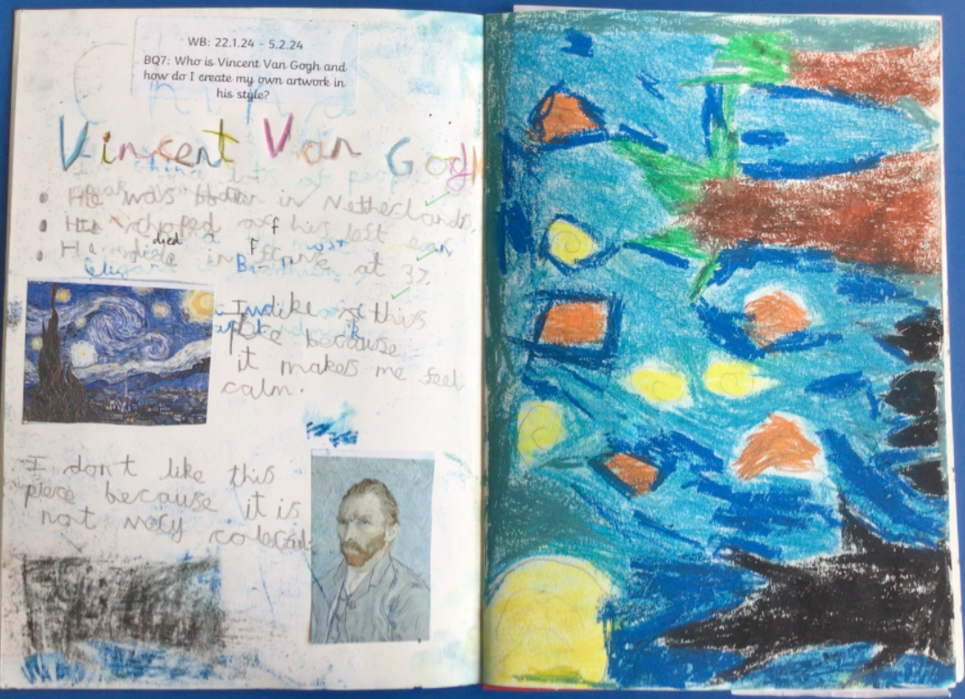
Feedback from teachers
Sketch books working well and show progression, range of skills and mediums
A range of artists covered
All sketch books show evidence of opinion and work of artists
Evaluations need to be more purposeful
Assessment is challenging as it can be very subjective
Children don’t feel like they are doing enough
Skills being covered during the two year rolling programme

Slide 5
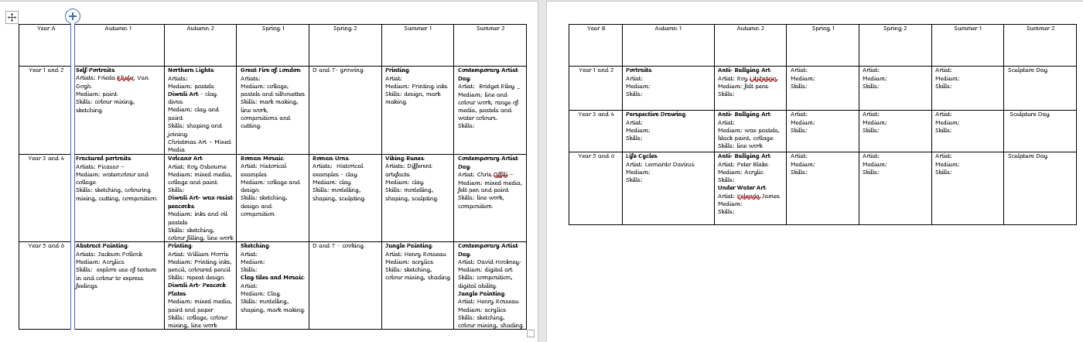
Overview created to ensure no overlaps and skills all covered.

Slide 6
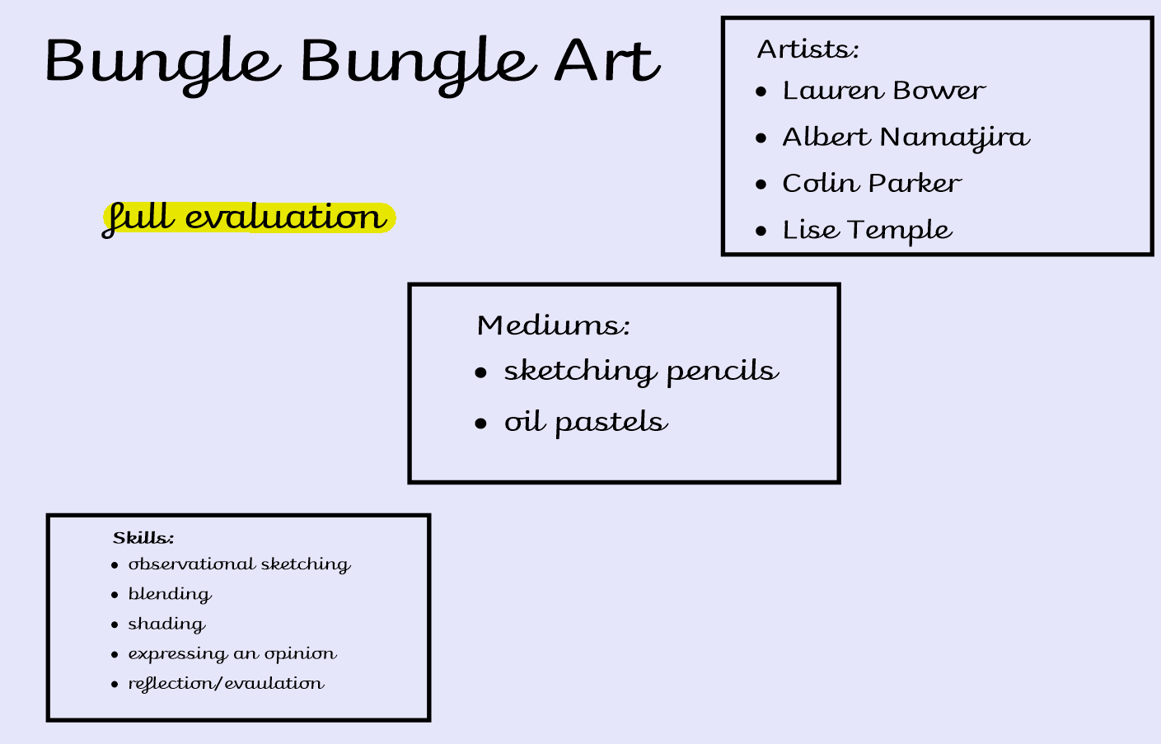
New first screen for all art lessons so skills, mediums and artists studies are clear to children and teachers.

Slide 7
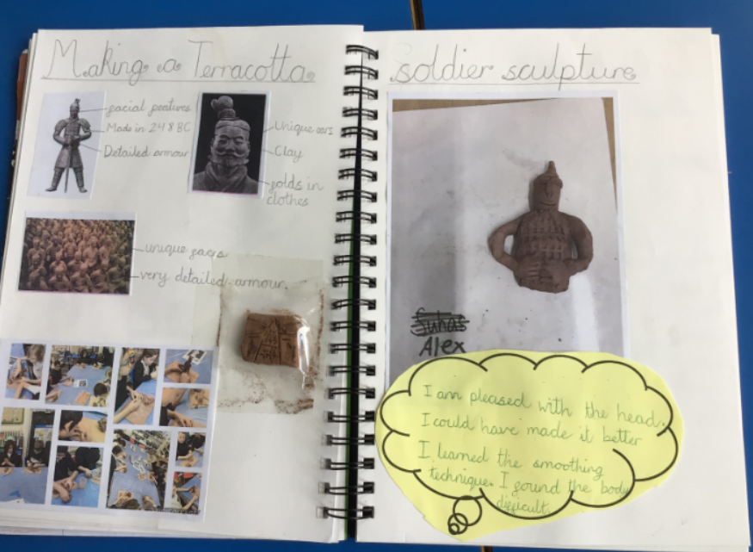
Year 5 sketch book from Chinese Culture Day to show consistency of sketch book features
Either information or observation about artist or craft person. Can be opinions too!
Photograph or actual final piece.
Practicing of techniques.
e.g. piece of clay with texture practice.
Could be a sketch or medium sample.
Informal thoughts on how the piece went.
What worked well?
What didn’t work so well?
What would you change?

Slide 8
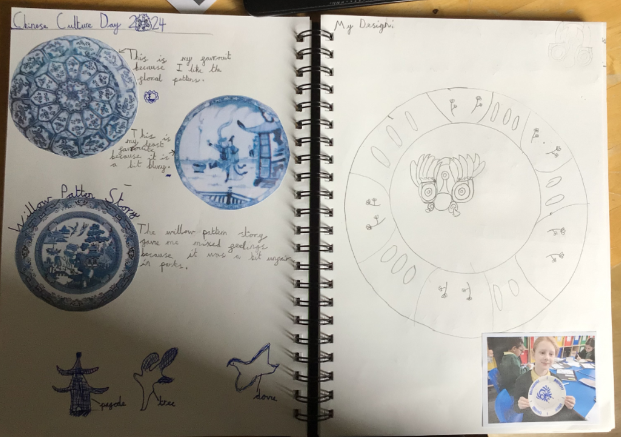
Year 3 sketch book from Chinese Culture Day to show consistency of sketch book features
Informal thoughts on how the piece went.
What worked well?
What didn’t work so well?
What would you change?
Either information or observation about artist or craft person. Can be opinions too!
Practicing of techniques.
e.g. piece of clay with texture practice.
Could be a sketch or medium sample.
Photograph or actual final piece.

Slide 9
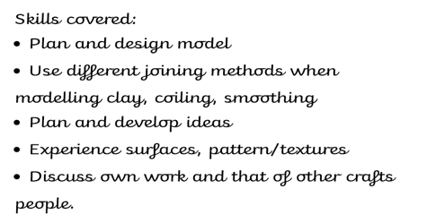
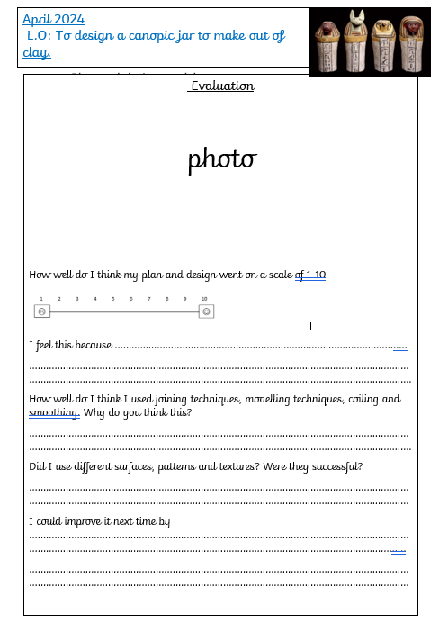
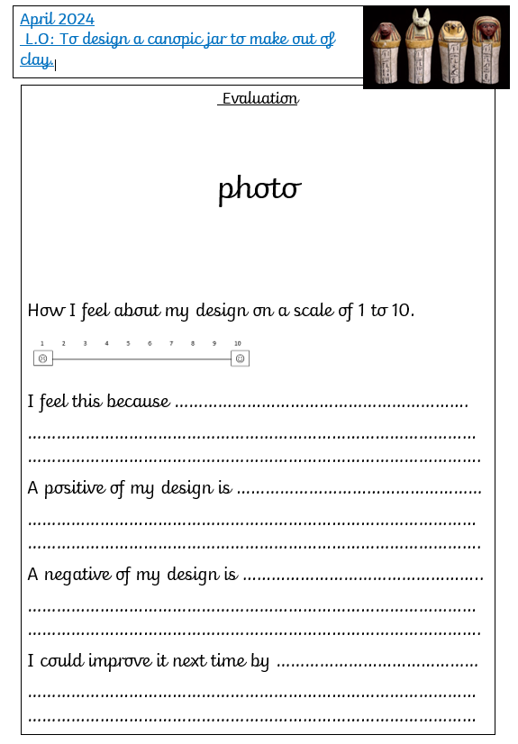
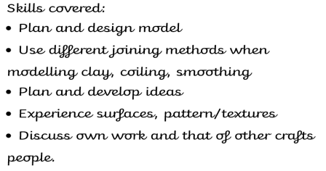
Update on evaluation.
After feedback from the teachers the evaluation is going to be updated to be more linked to the skills used.
Design and Technology successfully implemented a marking grid which included the skills.
This will allow teachers to assess the art easier and ensure the children’s evaluations are purposeful.

Slide 10
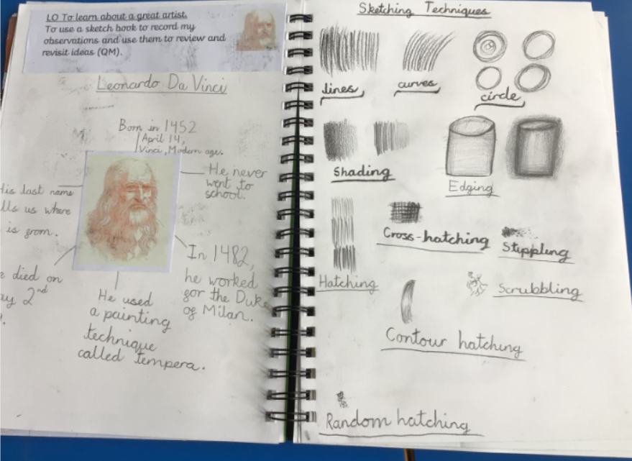
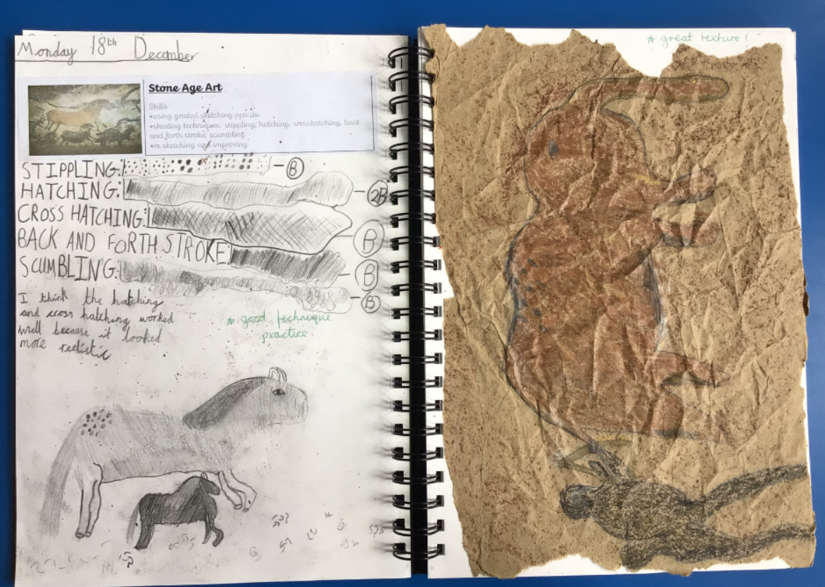
Year 3
Year 5
Progression of sketching techniques evident in sketch books.
Existing techniques revisited and new techniques introduced and implemented.

Slide 11
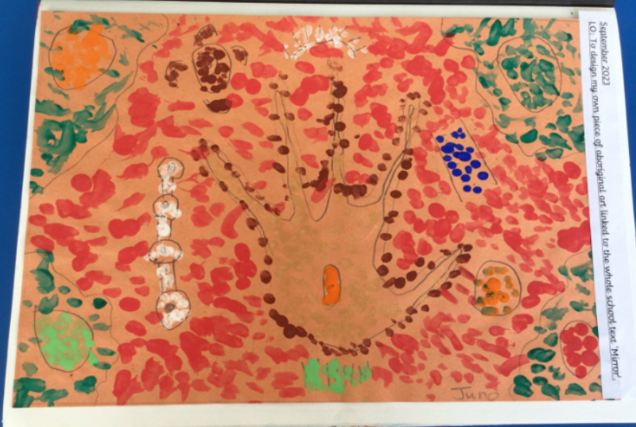
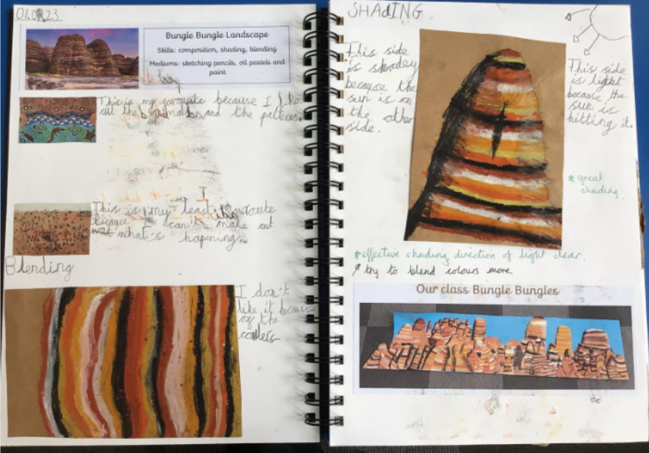
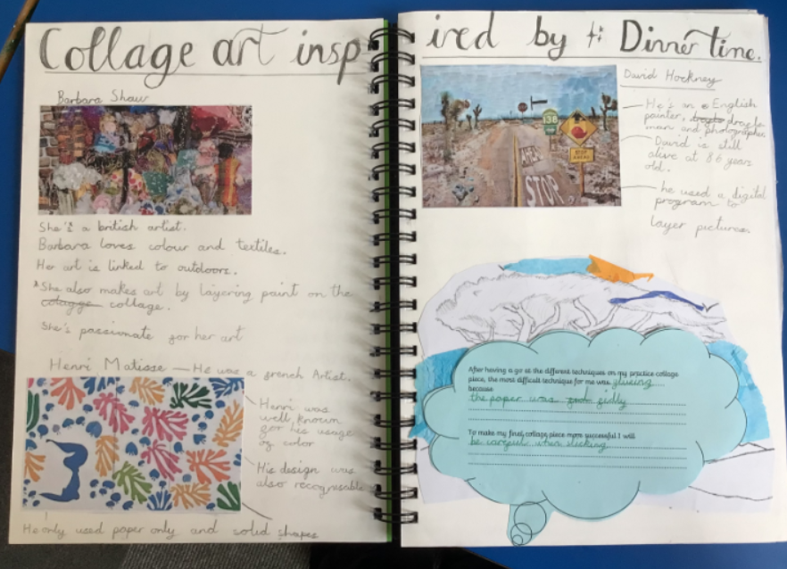
Whole school text Mirror Mirror.
Year 1 and 2 : Aboriginal Art using finger prints.
Year 3 and 4 : Bungle Bungle art using oil pastels, blending and shading
Year 5 and 6: Dinner Time Collage using mixed media and composition ideas

Slide 12
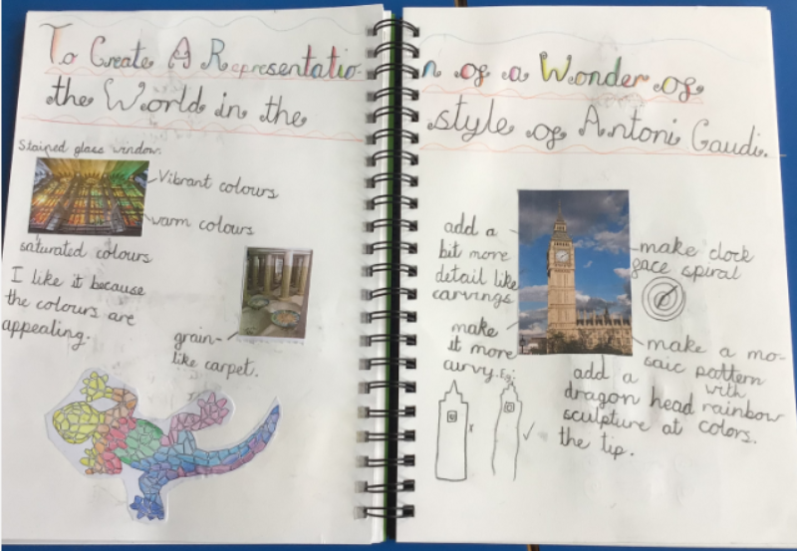
Extra-Curricular Development
Avenue After School Club includes a range of art and craft activities Monday to Thursday.
New clubs include Manga comic art and Artists.
After school clubs include art and craft and sewing club.
Modern Artist’s Day – Summer term 2023. Each phase was given a particular artist to focus on with children learning about that artist, their style and techniques. The children then produced a piece of work in the style of that artist.
The bottletop mural has just been installed in the big hall. Classes researched an ocean animal linking it to their science learning during Environment Week and then produced a bottletop animal.
Art is also included in activities linked to themed days/weeks and religious celebrations e.g. anti-bullying as well as RE competitions and What Do You Want to Be Day.

