Slide 1
WALK TO SCHOOL DAY

Slide 2
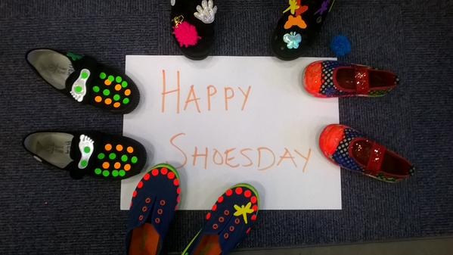
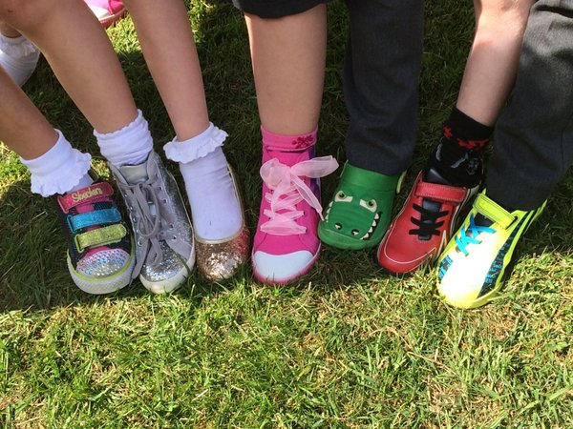
HAPPY SHOES DAY

Slide 3

SHOES FOR AFRICA
Donate clean shoes or £1

Slide 4

We have a big ambition:
every child that can, walks to school.
A generation ago, 70% of us walked to school – now it’s less than half.
We want to reverse this decline. We want children to be energised and empowered, and to make walking to school their natural choice.

Slide 5
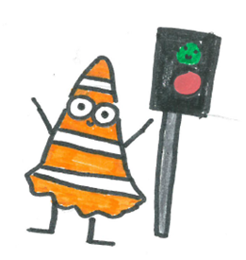
HAND UP
Who walked to school?
Who did park and stride?
Who walked or did park and stride?

Slide 6
Steve SAYS KEEP WALKING!

